Slide 1
Seeing UX through the Lens of Evolution: Unleash the superpowers inside of users’ mind!
Data Analysis Team / Nexon
Alan Kang
http://twitter.com/alankang
http://alankang.tistory.com
alankang@nexon.co.kr

Slide 2
What is common between all of them? Infectious disease Airports World Wide Web Human Brain Social Relationships

Slide 3
Albert-Laszlo Barabasi, “Linked: How Everything is Connected to Everything Else and What It Means” (2003)
 | Node | Link
Infectious disease | Infected Person | Infection
Airports | Airport | Airline route
World Wide Web | Web page | Hyperlink
Human Brain | Neuron | Connection
Social Relationships | Person | Relationship

Slide 4
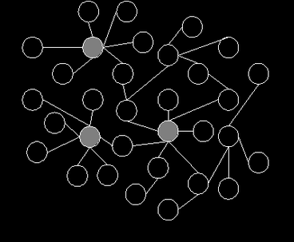
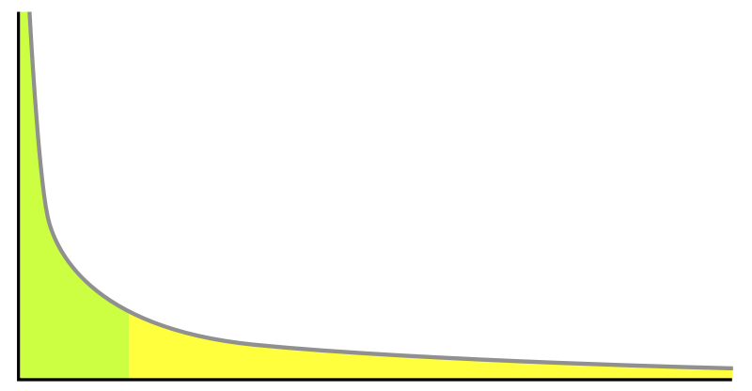
Albert-Laszlo Barabasi, “Linked: How Everything is Connected to Everything Else and What It Means” (2003)
The Lens of Complex Network Theory

Slide 5
There could be many lenses:
- The Lens of Complex Network Theory
- The Lens of System Dynamics
- The Lens of Statistics
…

Slide 6
Each lens provides an unique way of seeing and thinking to designers. The more the better :-)

Slide 7
I’ll talk about what we can discover with the lens of evolution: What evolution tells? How should we utilize it?

Slide 8
Ewald Hering, “Hering illusion” (1861) http://en.wikipedia.org/wiki/Hering_illusion

Slide 9
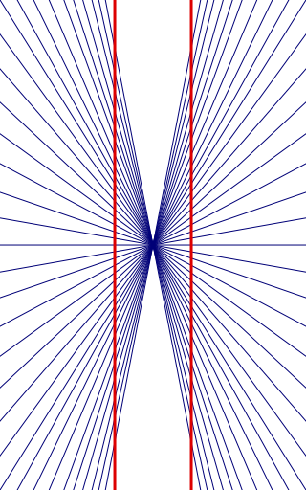
Ewald Hering, “Hering illusion” (1861) http://en.wikipedia.org/wiki/Hering_illusion

Slide 10
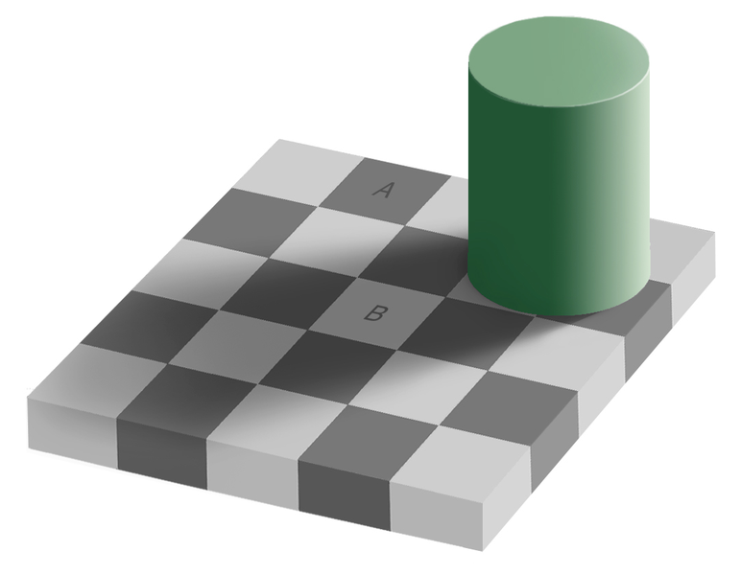
Edward H. Adelson, “Checkershadow Illusion” (1995) http://web.mit.edu/persci/people/adelson/checkershadow_illusion.html

Slide 11
Edward H. Adelson, “Checkershadow Illusion” (1995) http://web.mit.edu/persci/people/adelson/checkershadow_illusion.html

Slide 12
Edward H. Adelson, “Checkershadow Illusion” (1995) http://web.mit.edu/persci/people/adelson/checkershadow_illusion.html

Slide 13
Edward H. Adelson, “Checkershadow Illusion” (1995) http://web.mit.edu/persci/people/adelson/checkershadow_illusion.html

Slide 14
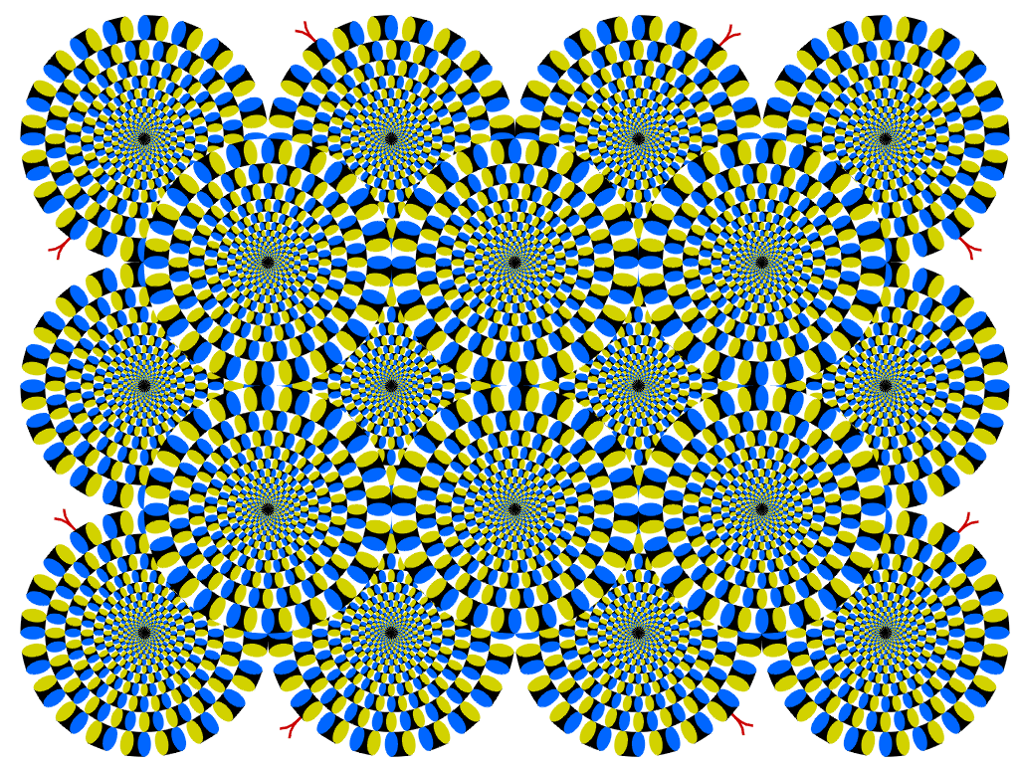
Akiyoshi Kitaoka, “Rotating Snakes” (2003) http://www.psy.ritsumei.ac.jp/~akitaoka/rotsnakes12e.html

Slide 15
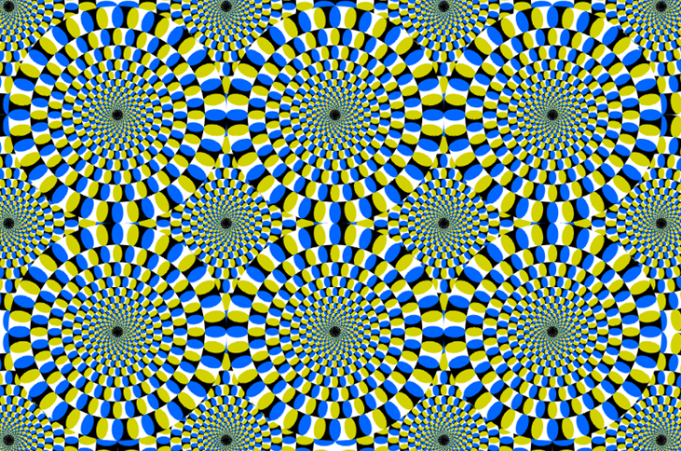
Akiyoshi Kitaoka, “Rotating Snakes” (2003) http://www.psy.ritsumei.ac.jp/~akitaoka/rotsnakes12e.html

Slide 16
There are thousands of these.

Slide 17
There is something weird in your eyes.

Slide 18
…and in your users’ eyes.

Slide 19
Not only eyes, but also ears.

Slide 20
H. McGurk, J. MacDonald, "Hearing lips and seeing voices," Nature, Vol 264(5588), pp. 746–748(1976) http://www.youtube.com/watch?v=aFPtc8BVdJk

Slide 21
What about thinking and reasoning? Are they somewhat broken, too?

Slide 22
If there is a “D” on one side of the card, then there is a “3” on the other side. Each of the following cards has a letter on one side and a number on the other. Indicate only the card(s) you definitely need to turn over to see if the rule has been violated.
D
E
3
4
Gerd Gigerenzer, “Adaptive Thinking – Rationality in the Real World“ (2000)

Slide 23
If there is a “D” on one side of the card, then there is a “3” on the other side. Each of the following cards has a letter on one side and a number on the other. Indicate only the card(s) you definitely need to turn over to see if the rule has been violated.
D
E
3
4
Gerd Gigerenzer, “Adaptive Thinking – Rationality in the Real World“ (2000)

Slide 24
It’s a simple propositional logic: D → 3 The only logical falsity: D & not 3

Slide 25
You are not the only one. Only about 10% of the participants select the right cards.

Slide 26
These are illusions, errors and/or biases. Our minds are somewhat broken.

Slide 27
“I knew it! That explains why my users are so stupid!”

Slide 28
Depressed? You don’t have to.

Slide 29
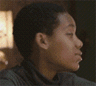
The conclusion above could be changed radically with the lens of evolution: These are not illusions, bias and/or errors but superpowers.

Slide 30
#1 We can see the future.

Slide 31
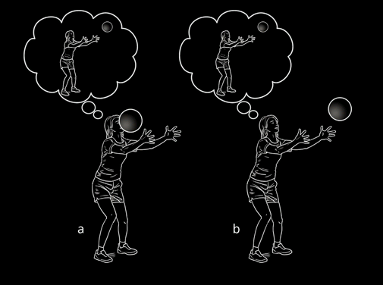
We need to see future anyway.
Mark Changizi, “The Vision Revolution“ (2009)

Slide 32
But how?

Slide 33
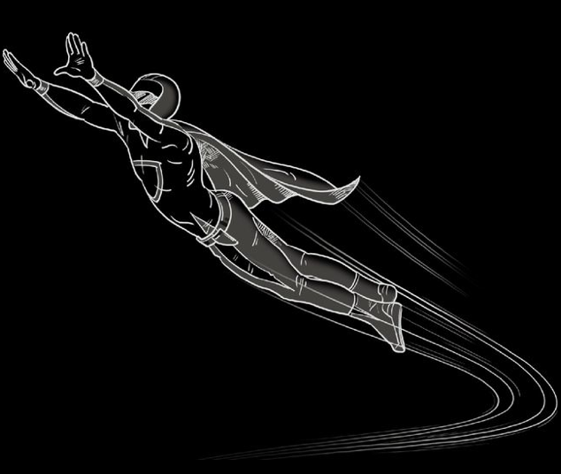
Mark Changizi, “The Vision Revolution“ (2009)

Slide 34
Mark Changizi, “The Vision Revolution“ (2009)

Slide 35
Ewald Hering, “Hering illusion” (1861) http://en.wikipedia.org/wiki/Hering_illusion

Slide 36
Most visual illusions occur because of artificial, unnatural inputs. So, don’t blame your eyes.

Slide 37
#2 We unconsciously use visual cues to improve speech recognition.

Slide 38
H. McGurk, J. MacDonald, "Hearing lips and seeing voices," Nature, Vol 264(5588), pp. 746–748(1976) http://www.youtube.com/watch?v=aFPtc8BVdJk

Slide 39
McGurk effect occurs because of artificial, unnatural inputs.

Slide 40
#3 We automatically select appropriate mode of computation for a given situation.

Slide 41
If there is a “D” on one side of the card, then there is a “3” on the other side. Each of the following cards has a letter on one side and a number on the other. Indicate only the card(s) you definitely need to turn over to see if the rule has been violated.
D
E
3
4
Gerd Gigerenzer, “Adaptive Thinking – Rationality in the Real World“ (2000)

Slide 42
“If you borrow my car, then you have to fill up the tank with gas.” Indicate only the card(s) you definitely need to turn over to see if the rule has been violated.
Borrowed
Didn’t
borrowed
Filled up the tank
Didn’t
filled up the tank
Gerd Gigerenzer, “Adaptive Thinking – Rationality in the Real World“ (2000)

Slide 43
Our mind doesn’t work well with abstract propositional logic: P → Q Logical falsity: P & not Q

Slide 44
But it works well with cheater detecting situation: If you take the benefit, then you have to pay the cost. Logical falsity: Benefit taken and cost not paid.
Jerome H. Barkow, Leda Cosmides, John Tooby,
“The Adapted Mind Evolutionary Psychology and Generation of Culture” (1995)

Slide 45
Difficulty with a propositional logic disappears when we dealing with natural, appropriate situation.

Slide 46
General conclusion:
- There are fine tuned special abilities in our mind.
(Massive Modularity Hypothesis)
- They are activated only with appropriate inputs.
(Domain Specificity Hypothesis)

Slide 47
Briefly? The mind is designed to deal with complexity of the world.

Slide 48
What does it tell about design?
- Users are not stupid but interfaces(and designers)
are. Designers are forcing users to do inhumane
things.
- With careful design, we can utilize these abilities
to make users super-smart.
- Conventional UI Guidelines could be largely
improved.

Slide 49
Some applications?

Slide 50
According to Edward Tufte, information visualization guru, we should minimize non-data-ink.
Edward Tufte, “The Visual Display of Quantitative Informations”

Slide 51
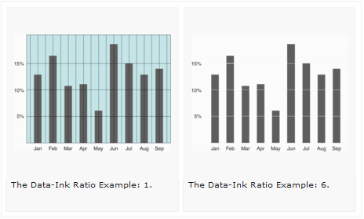

Slide 52
But sometimes, non-data-ink is data-ink.

Slide 53
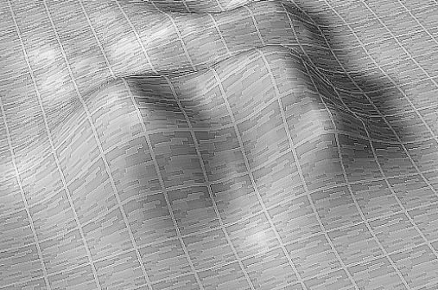
Colin Ware, “Information Visualization – Perception for Design” (2004) http://en.wikipedia.org/wiki/Hering_illusion

Slide 54
Colin Ware, “Information Visualization – Perception for Design” (2004) http://en.wikipedia.org/wiki/Hering_illusion

Slide 55
J. J. Gibson, “The Ecological Approach to Visual Perception” (1979)
A surface is substantial; a plane is not.
A surface is textured; a plane is not.
A surface is never perfectly transparent; a plane is.

Slide 56
Or we can save lives with visual illusion.

Slide 57
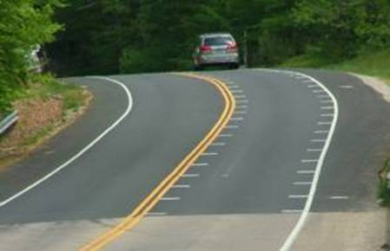
Optical Speed Bar - Alternatives to Speed Cameras Prove Effective (2007) http://www.wired.com/autopia/2007/07/alternatives-to/

Slide 58
“Optical speed bars are spaced to give the impression that a car is traveling at a faster speed than it actually is. Results from the study show that drivers slowed 4 to 12 percent when encountering the bars.”
Optical Speed Bar - Alternatives to Speed Cameras Prove Effective (2007) http://www.wired.com/autopia/2007/07/alternatives-to/

Slide 59
I think these are only beginning. With profound understanding of human mind, we can design “things that makes us super-smart.” ;-)

Slide 60
There are whole new superpowers waiting to be exploited in our mind.

Slide 61
There are stunning discoveries waiting to be applied and tested.

Slide 62
“So what? We are designers, not scientists.”

Slide 63
Whenever we design something we are making hypotheses. Whenever we release services/products we are performing experiments to support or disprove hypotheses. E.g. A/B Test is a controlled experiment.

Slide 64
Wouldn’t it be great if we have some place to discuss these things?
- Discussing how to apply evolutionary thinking to
product/service design? - Sharing of ideas, knowledge, discoveries you have
found and/or studied recently.
- Forming study groups with people who have
similar interest.

Slide 65
Please let me invite you: http://groups.google.com/group/aepdg (Applied EP Discussion Group) There’s nothing there yet and I don’t know what can we do. But who knows? It could be a start of something.

Slide 66
Thank you!
http://twitter.com/alankang
http://alankang.tistory.com
alankang@nexon.co.kr

